Slide 1
CAR Administrator Calibration Meeting - CAR Review -
February 26 2013
Team A: Paul Ip, Thomas Kestner, Balina Ling, Kila Yang

Slide 2
Agenda
CARs to be reviewed:
123910386 (by Kila Yang)
123910883 (by Thomas Kestner)
123911401 (by Paul Ip)
“exemplary” 123911363 (by Balina Ling)

Slide 3
CAR No. 123910386 / Kila Yang

Slide 4
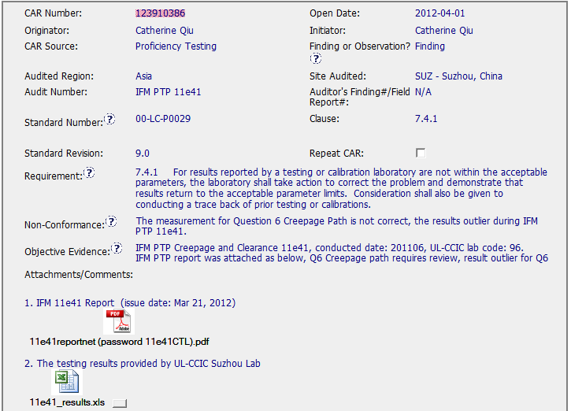
CAR No. 123910386

Slide 5
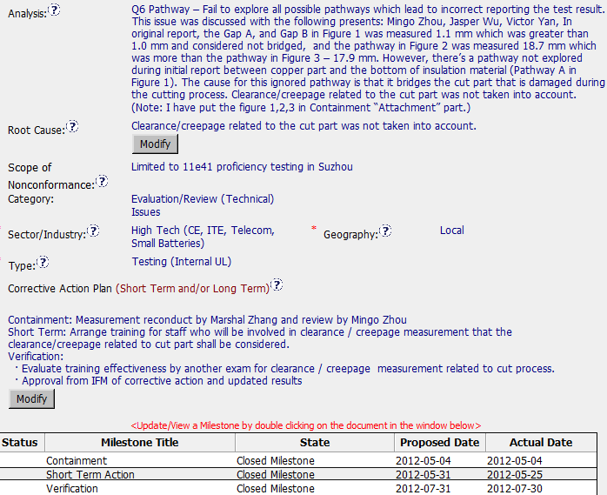
CAR No. 123910386
The analysis is clear to describe why the non-conformance was happened, and the stakeholders were involved in this analysis. And also has clear path to determine the root cause.
However, the analysis did not state how widespread this problem is. Therefore, how to determine the scope of NC was limited to this PTP only?
Containment / Short Term Action / Verification included in this Finding CAR

Slide 6
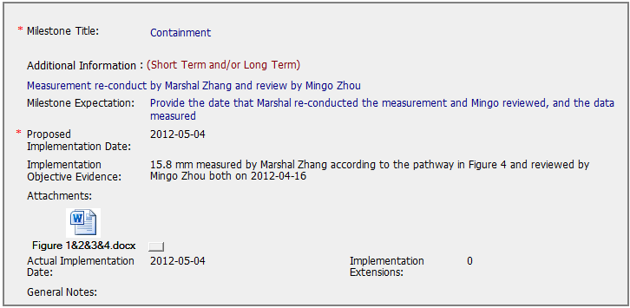
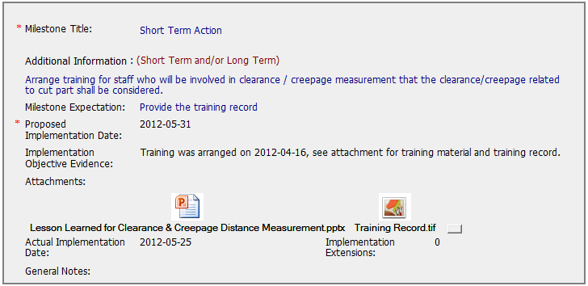
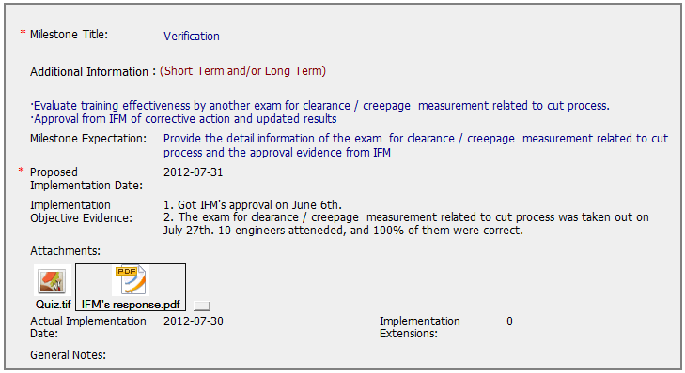
CAR No. 123910386
The implementation of corrective action had met the milestone expectations in each phases.

Slide 7
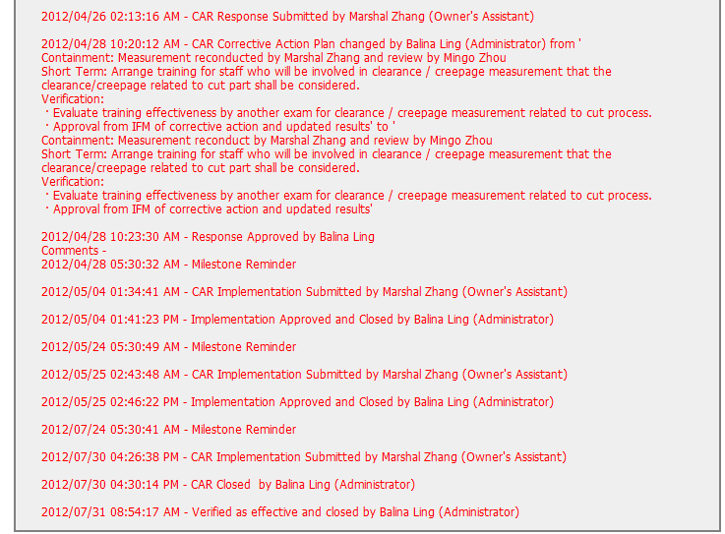
CAR No. 123910386
CAR Admin has approved in a timely manner when CAR Owner submitted the response/implementation

Slide 8
CAR No. 123910883 / Thomas Kestner

Slide 9
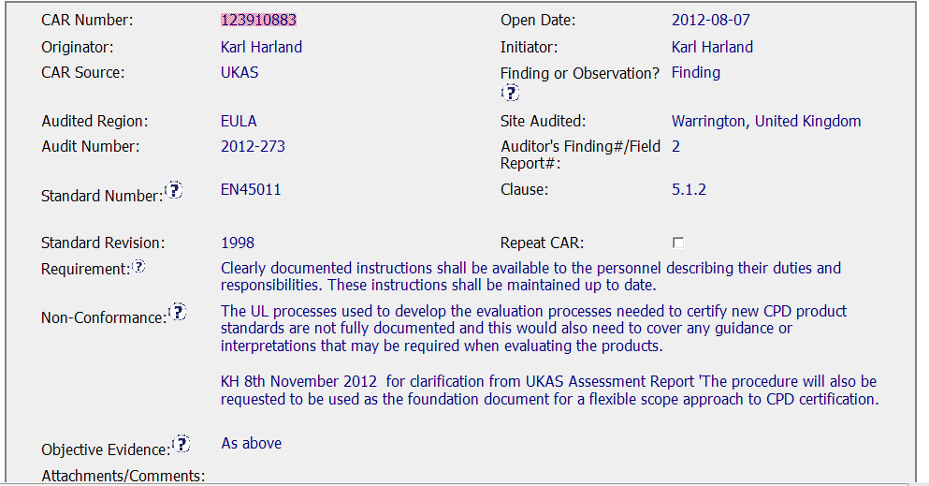
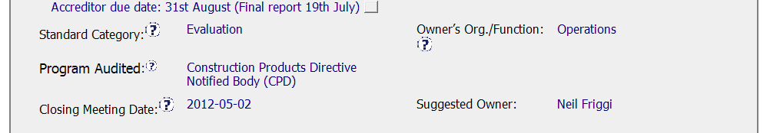
CAR Origination
The non-conformance statement and objective evidence are very clear. Accreditor due date is specified.

Slide 10
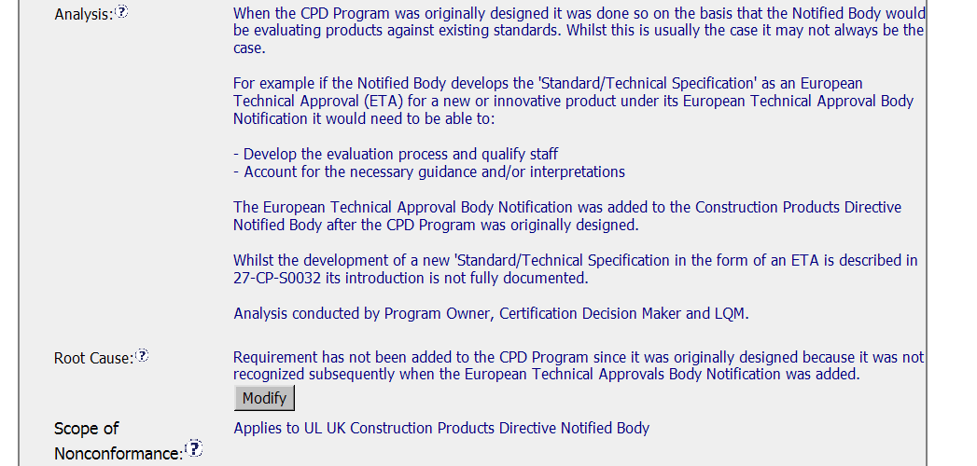
Root Cause Analysis & Scope,
The analysis does not include consideration of already certified products.

Slide 11
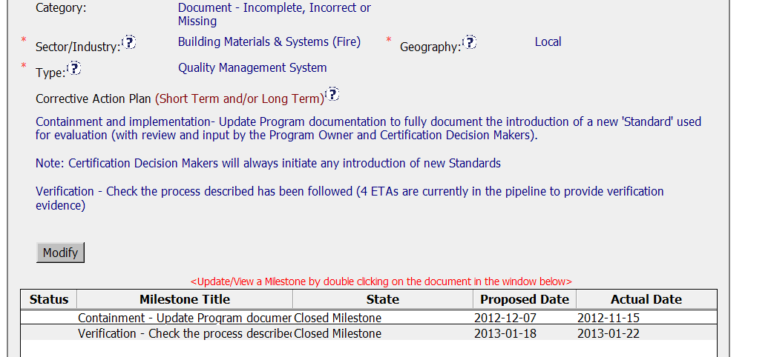
Corrective Action Plan
Corrective action plan specifies a containment plan, but does not address past projects.

Slide 12
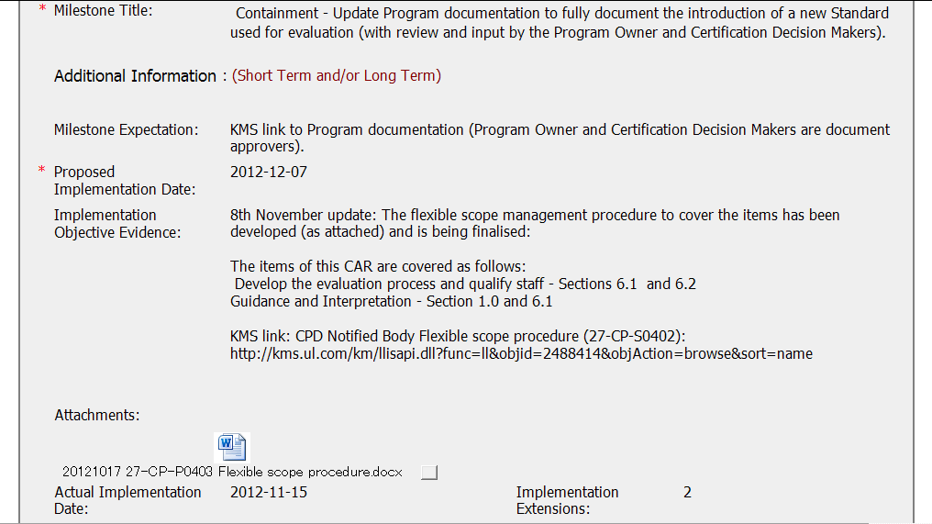
Milestone – Implementation Evidence
Procedure was created and published in KMS, but containment not addressed, although milestone title is “containment”.

Slide 13
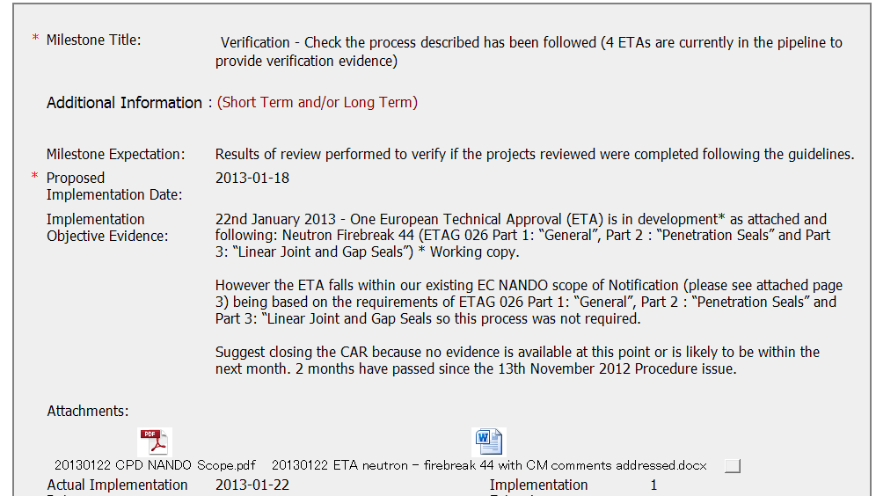
Verification
Verification was attempted, but there was no actual project.

Slide 14

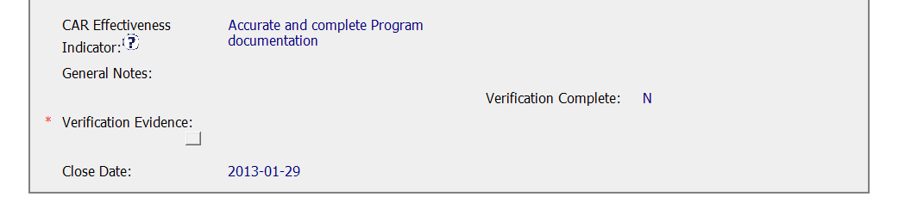
CAR State
CAR Admin needs to verify effectiveness.

Slide 15
CAR No. 123911401 / Paul Ip

Slide 16
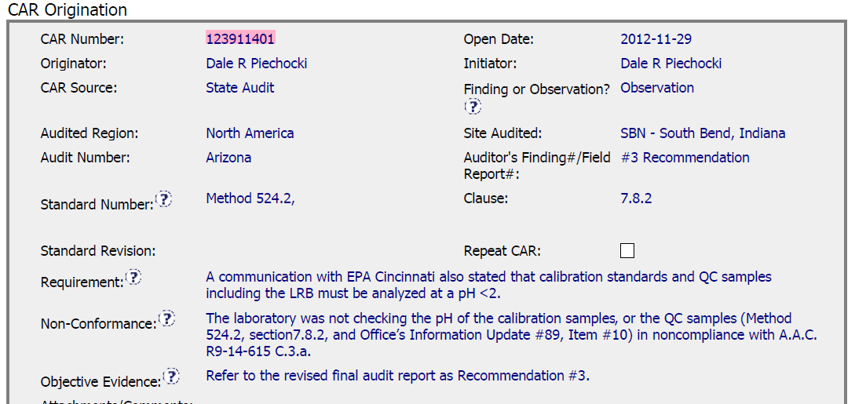
CAR No. 123911401
State Audit for Water Quality
Observation
NC: According to requirement, a technical data from samples was not checked

Slide 17
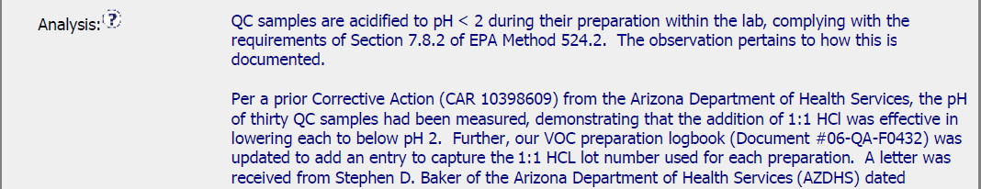
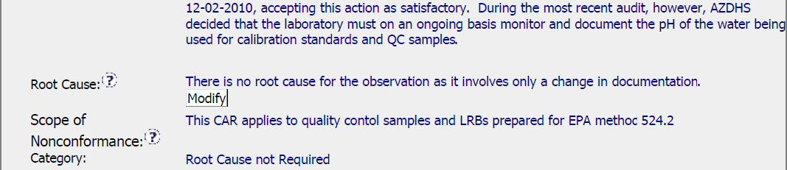
CAR No. 123911401
Analysis : Provided although it was an observation CAR. CAR Owner provided much information to explain UL meeting the requirement, just only not record the data in Datasheet. Therefore, it would be reporting issue instead of technical issue. Thus, considered this CAR to be an OBSERVATION rather than FINDING.
It was considered as a good practice
Root Cause : Not Required
Scope of Nonconformance: limited to the objective evidence provided for the nonconformance.
Category: Root cause not required

Slide 18
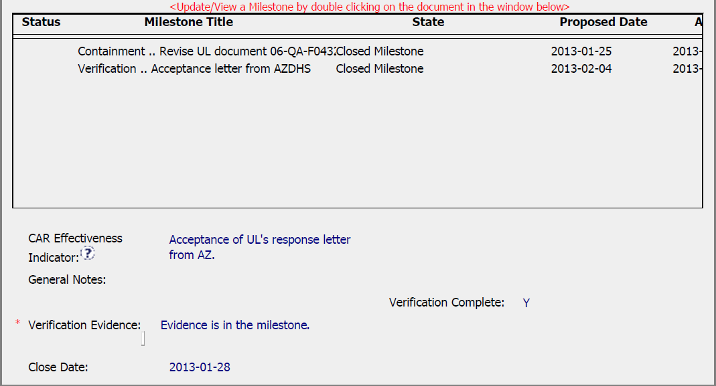
CAR No. 12311401
Milestone: Completed per milestone expectation and provided enough evidence
Verification: Occurred immediately after acceptance of the last milestone

Slide 19
CAR No. 123911363 (exemplary) / Balina Ling

Slide 20
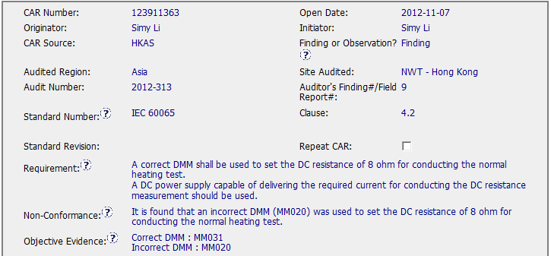
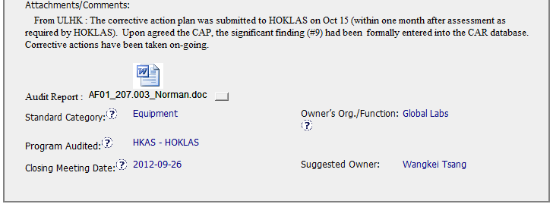
Exemplary Finding CAR No. 123911363

Slide 21
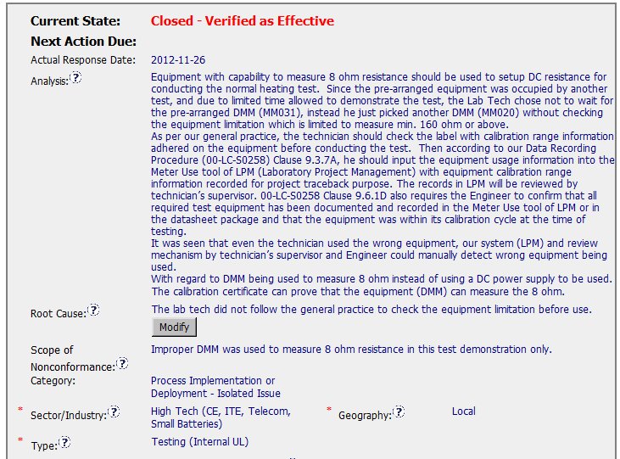
Exemplary Finding CAR No. 123911363
1. Clear analysis and describe with facts. And the root cause is reasonable and complete based on the analysis.
1
2
2. Scope tells us how widespread the problem is, for this CAR, it is just limited to this demonstration test.

Slide 22
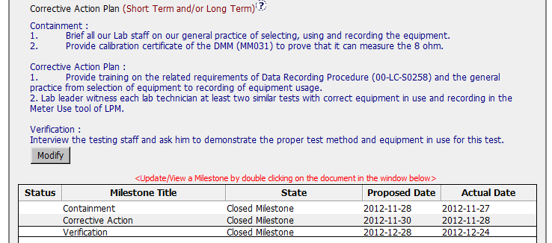
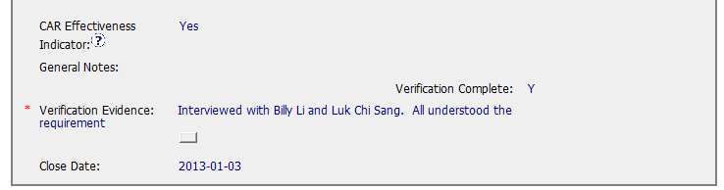
Exemplary Finding CAR No. 123911363
3
3. Containment ,corrective action and verification fix the objective evidence, address the entire root cause and address the items identified in the analysis, there is one suggestion, it is better to move verification to containment step 2 and move corrective action plan step 2 to verification.

Slide 23
Exemplary Finding CAR No. 123911363 Discussion
Clear analysis and describe with facts. And the root cause is reasonable and complete based on the analysis.
Scope tells us how widespread the problem is, for this CAR, it is just limited to this demonstration test.
Containment ,corrective action and verification fix the objective evidence, address the entire root cause and address the items identified in the analysis, there is one suggestion, it is better to move verification to containment step 2 and move corrective action plan step 2 to verification.

Slide 24
Thank you!!!

Slide 25
CAR Review, 1Q, 2013
Barbara Scala, Jim Carlisle, Kyle Huang

Slide 26
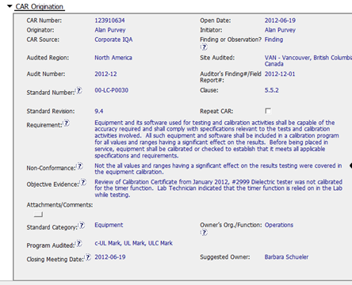
Why a finding when only 1 pc. Of equipment is cited in OE.
The NC does reflect the requirement.

Slide 27
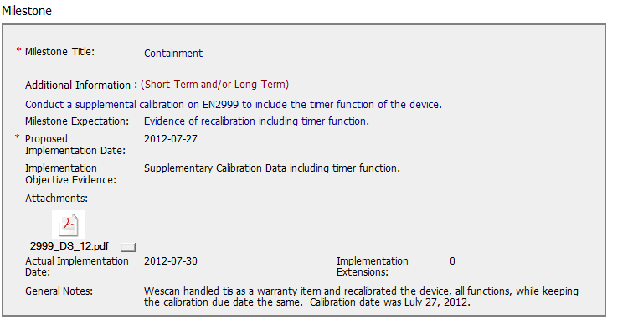
Good Containment milestone!

Slide 28
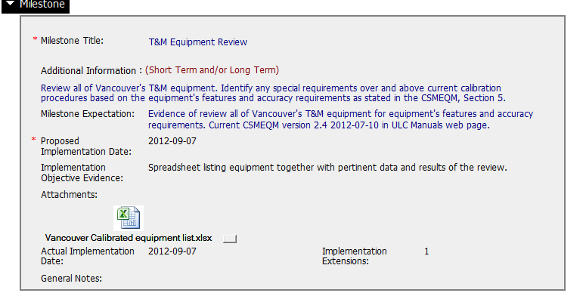
Good CA milestone regarding all equipment!!

Slide 29
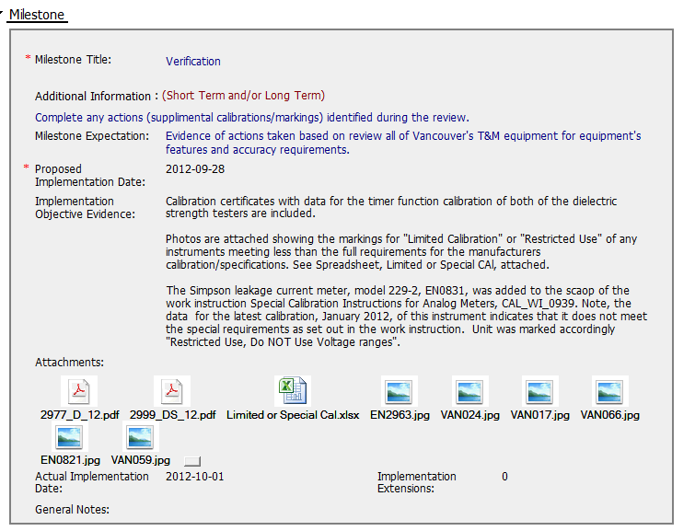
Excellent Verification milestone!! Good work!

Slide 30
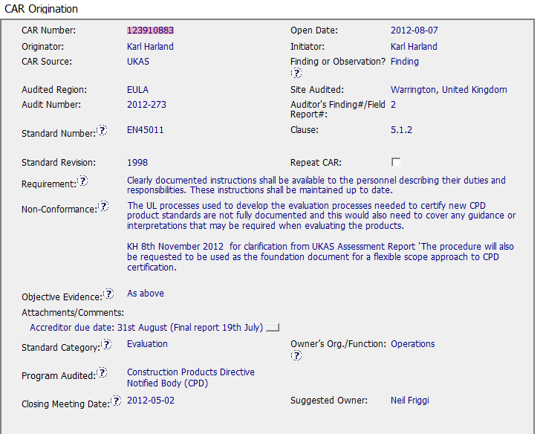
The NC does not support the requirement, & goes into personal preference by the auditor regarding what should be done. Processes cited in the NC do not say which processes are documented & no indication of what document needs to be addressed regarding the CA.
The OE is unclear??

Slide 31
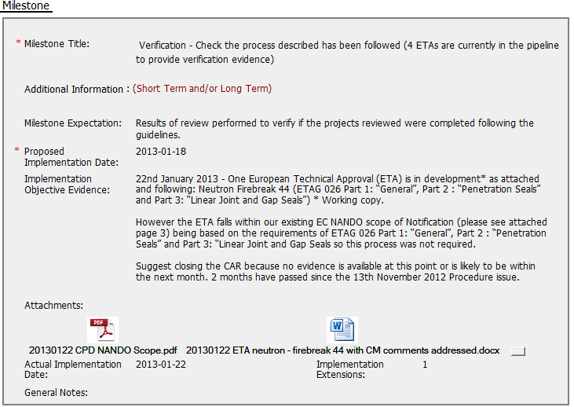
The verification milestone does not include evidence that CA taken was effective. The CAR was recommended for closure too soon.

Slide 32
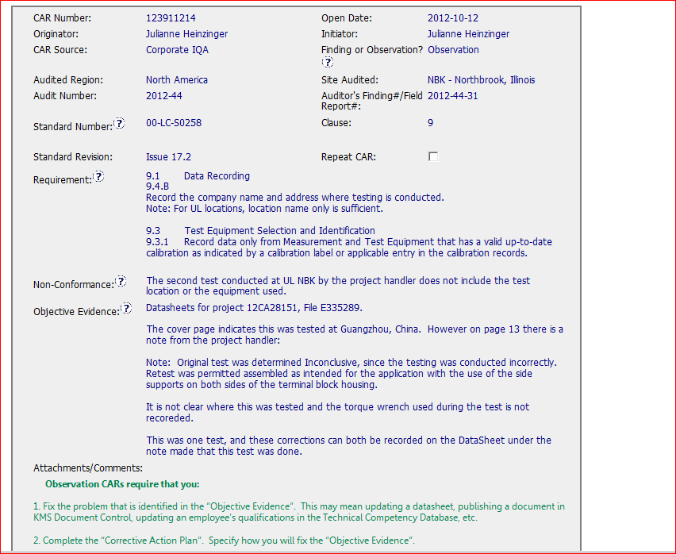
CAR 123911214
Good instruction provided

Slide 33
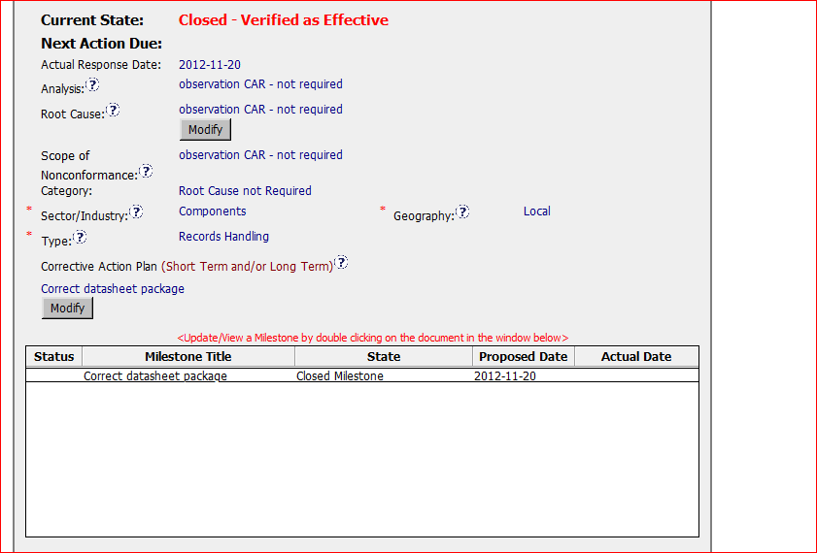
CAR 123911214
Following the procedure regarding to Analysis, Root cause, Scope and category

Slide 34
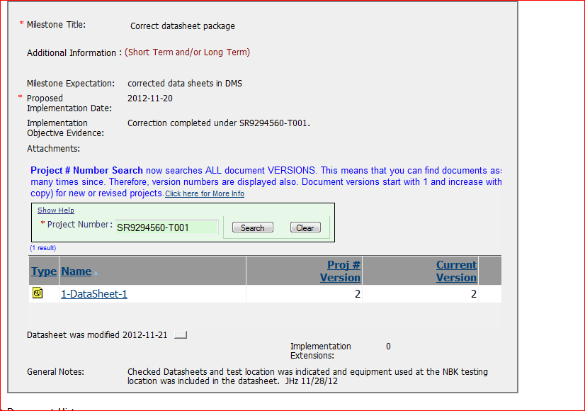
CAR 123911214
Attachment with information from DMS provided as the evidence
Comments

Slide 35
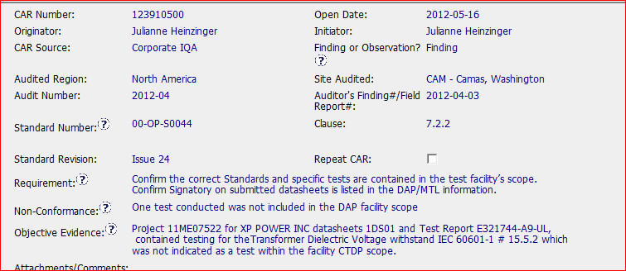
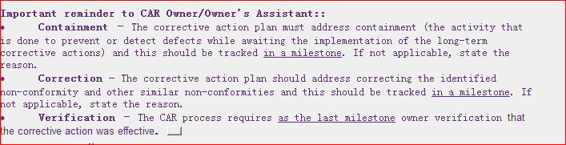
CAR 123910500
Good Information for CAR owner

Slide 36
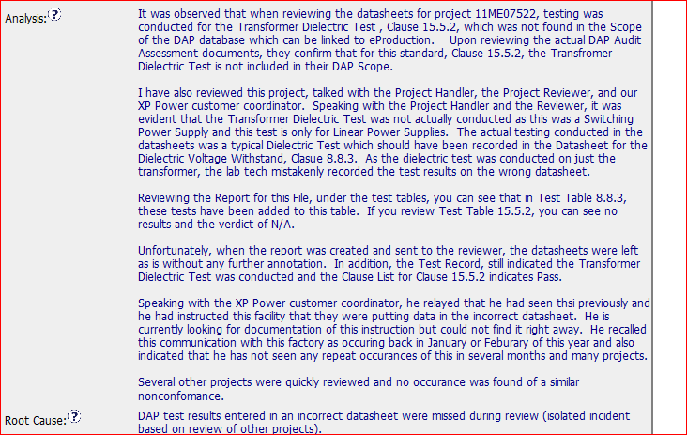
Good Example - CAR 123910500
Identifying the stakeholder
Analysis of scope

Slide 37
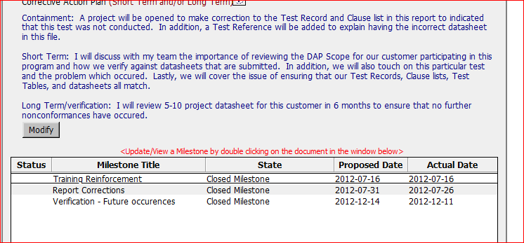
Good Example - CAR 123910500
Having action to prevent it from reoccurrence
Having containment and Verification milestones

Slide 38
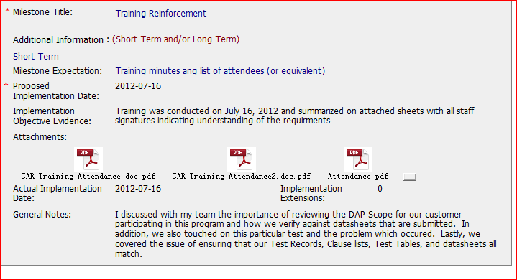
Good Example - CAR 123910500
Including the training content and attendance sheets

Slide 39
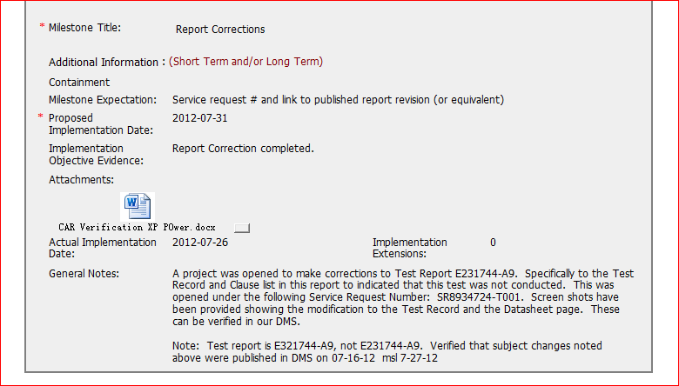
Good Example - CAR 123910500
Having the confirmation information for DMS

Slide 40
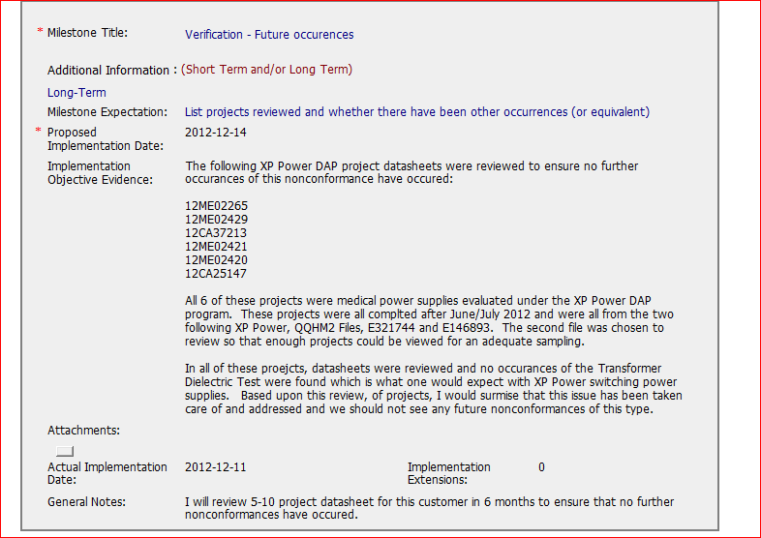
Good Example - CAR 123910500
Having project listed and statement regarding to the verification results

Slide 41
Q1 2013 CAR Analysis
Team:
Bill Konigsfeld
Alan Purvey
Jenni Murrill

Slide 42
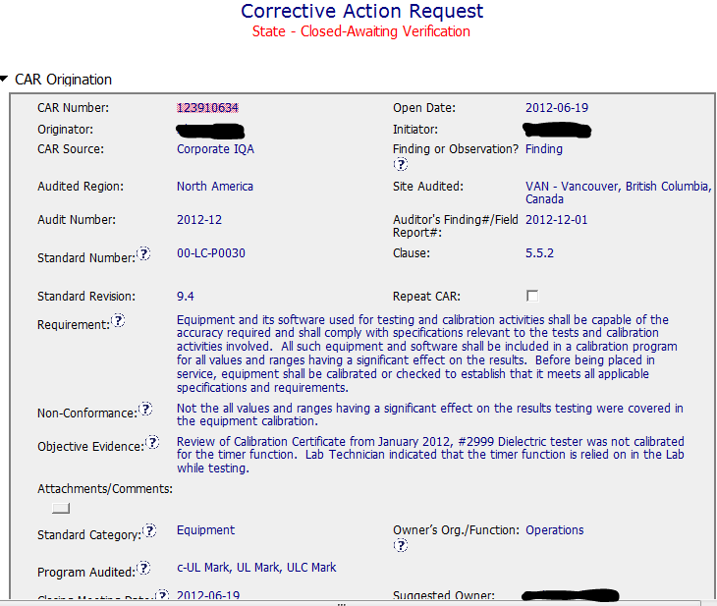
Finding: Good CAR
NCR: suitable information including identification of the cited unit is properly stated in the Requirement, NCR and Obj. Evidence sections.
Background

Slide 43
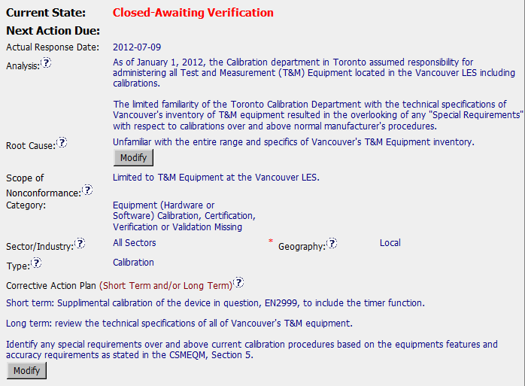
Finding: Good CAR
Analysis / Scope: audit limited issue to just the single site, unit in obj. evidence was sent to have the timer calibrated. No adjustment needed. No traceback required. Previous calibration included timer. Review of other equip. handled in milestone. Stakeholders - CAR Owner is also sole process Owner.
Owner
response
CAP: Milestones identified are appropriate. Unit sent out during audit. Other equip. reviewed in 2nd milestone.

Slide 44
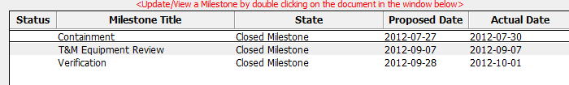
Finding: Good CAR
Milestones
Milestones: are appropriate. Unit sent out during audit for calib. Other equip. reviewed in 2nd milestone. Verification included data on the units identified in the 2nd milestone.
Recommendations for improvement: details known during the audit not present in the CAR & would assist in understanding. Doc History: request for addition as Opt. Recipient not implemented.

Slide 45
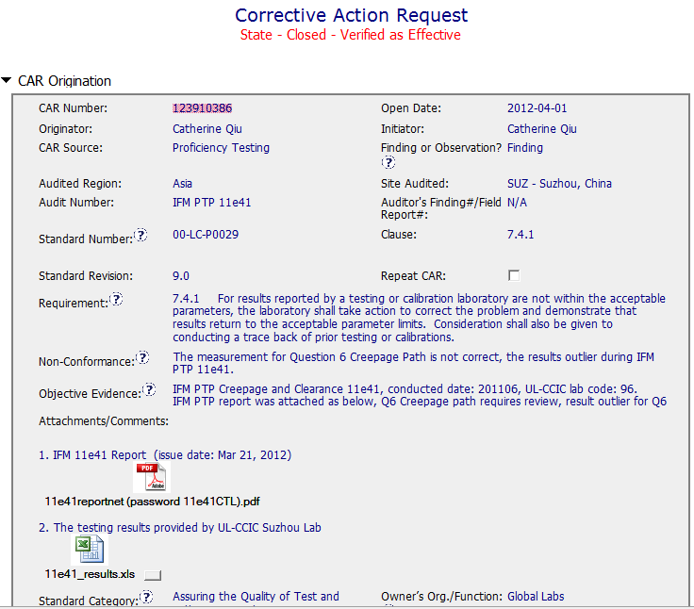
Finding
Suitable information appears to be properly stated in the Requirement, NCR, and Obj. Evidence
OFI: Identify response due date to IFM.
Original IFM Report and test data included for background information.

Slide 46
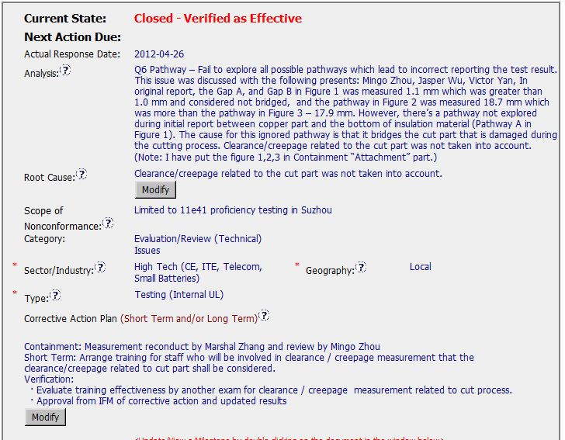
Finding :123910386
Analysis: Includes stakeholders but not role in analysis. Good explanation of what measurement was missed and why.
CAP: Appropriately addresses short term and long term actions.

Slide 47
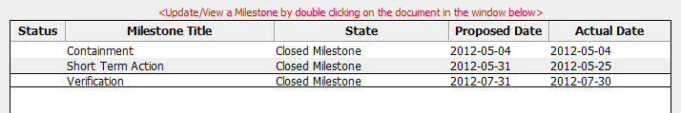
Finding 123910386
Records of the re-measurement submittal to IFM, Record of Training/participants, record of reevaluation of staff, record of acceptance from IFM are contained in milestones.
OFI: Comment from IFM in verification:
“ I would just comment that although the sectioning of the sample would undoubtedly have contributed to the failure to explore all pathways, an equivalent pathway on the side of the contact not sectioned would still have been intact, but this was also missed.
Nevertheless, the CAR is accepted and I confirm that this completes the follow- up action with IFM.”
Owner could have addressed the alternate missed element by reconducting training or at a minimum informing staff.
Best Practices?:
The verification milestone includes a record of a quiz (C&C exercise) to determine effectiveness of training. All participants passed.

Slide 48
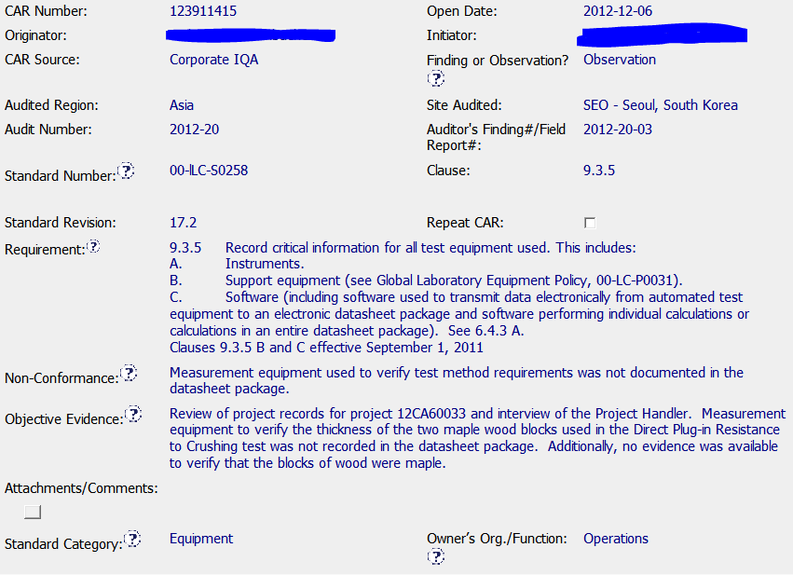
Observation 123911415
NCR: Suitable information, including identification of the project reviewed, is properly stated in the Requirement, NCR and Obj. Evidence sections.
Background
For future Observations, 1 of XX records reviewed will be documented.

Slide 49
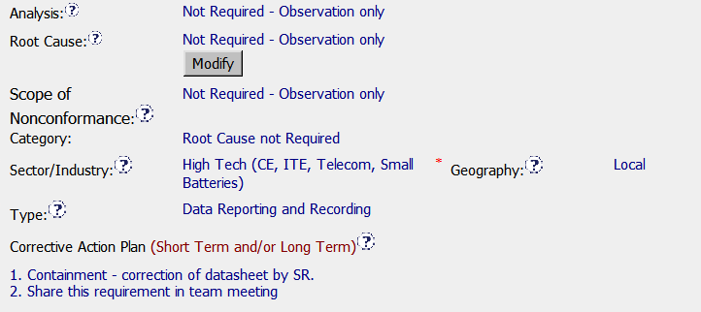

Observation 123911415
Response
Correct Root Cause Category for Observation
Milestones
Correction: datasheet updated to include wood blocks and calipers used for verification. Calibration record verifies the wood is Maple.
- Cited NCR corrected.
- Good practice of sharing with team, though this could have been handled outside of the CAR.

Slide 50


Observation 123911415
Verification
Simple, immediate verification for Observation

Slide 51
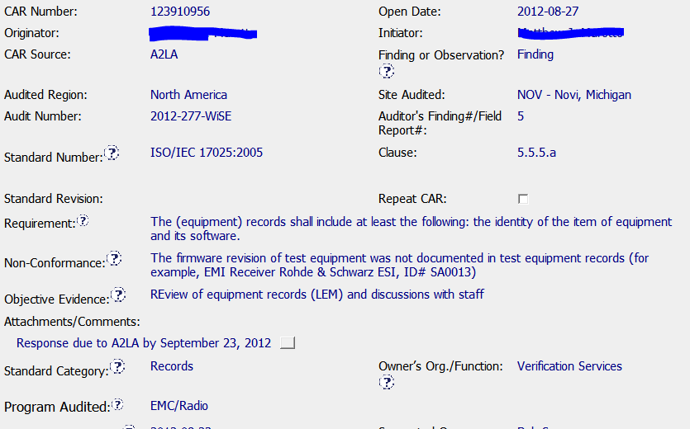
Exemplary Finding - 123910956
Background
Equipment description and ID included
Accreditor Due Date

Slide 52
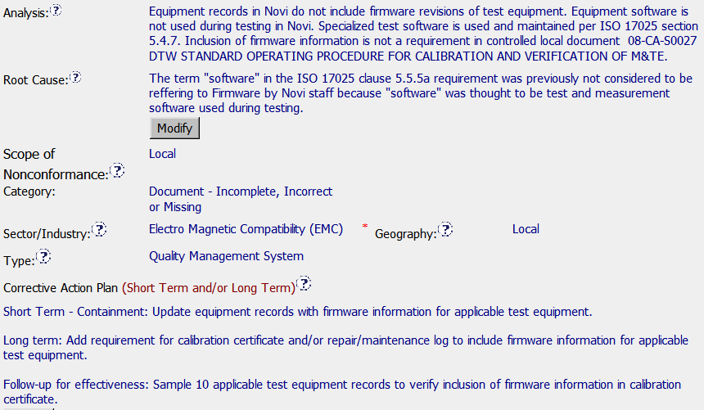
Exemplary Finding - 123910956
Clear explanation of how this was overlooked and support of root cause.
Response
Clear, concise Root Cause
Suggested Scope: Novi test equipment with firmware.
Could have included stakeholders
Containment & Verification

Slide 53

Exemplary Finding - 123910956
Milestones
Containment, Long Term and Verification Included.
Implemented with equipment staff through exercise
of updating equipment in LEM.

